Slide 1

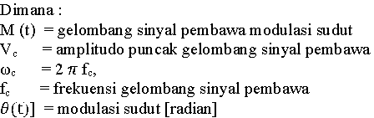
Modulasi Frekuensi (FM)
Modulasi Sudut :
Definisi: Modulasi sudut adalah modulasi yang
mana sudut sinusoida gelombang sinyal
pembawa ( ) diubah-ubah terhadap waktu.

Slide 2
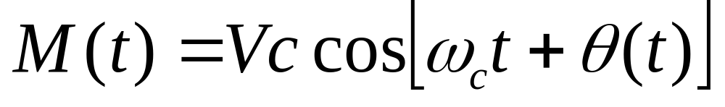

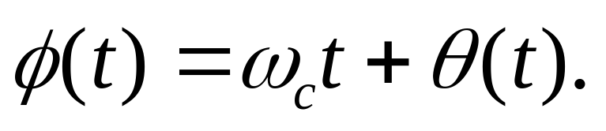
Pada modulasi sudut, sinyal carrier termodulasi
dirumuskan seperti berikut :
dimana Vc dan ω_{c} konstan, sementara sudut fasa Φ(t) adalah merupakan fungsi dari sinyal informasi Vm(t)
Persamaan diatas dapat di kita tulis kembali
menjadi persamaan berikut :
Dimana :

Slide 3
Modulasi sudut :
Modulasi Fasa (PM = Phase Modulation).
Modulasi Frekuensi (FM = Frequency Modulation)
Modulasi Fasa: Modulasi sudut yang mana sudut fasa
sesaat gelombang sinyal pembawa berubah
menyimpang dari harga referensi, sebanding
dengan perubahan amplitudo gelombang sinyal
pemodulasi (sinyal informasi).
Modulasi Frekuensi : Modulasi sudut yang mana
frekuensi sesaat gelombang sinus sinyal
pembawa berubah sebanding dengan harga
sesaat (aplitudo sesaat) gelombang sinyal
pemodulasi (sinyal informasi).

Slide 4

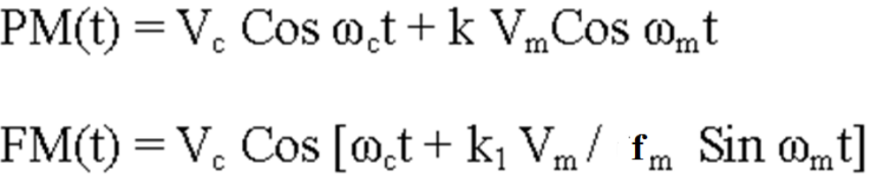
Persamaan matematis sinyal termodulasi :
Dimana k dan k₁ merupakan suatu konstanta dari
sensitivitas modulator
Untuk modulator PM, k = [radian/volt],
Untuk modulator FM, k₁ = [Hertz/volt].

Slide 5
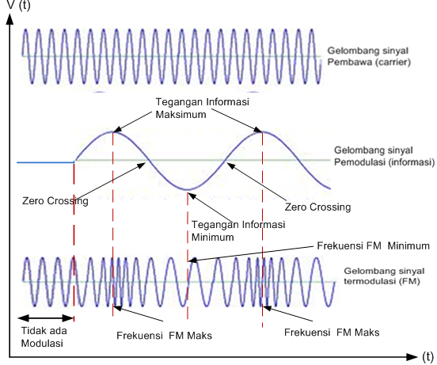
Bentuk Gelombang PM dan FM

Slide 6
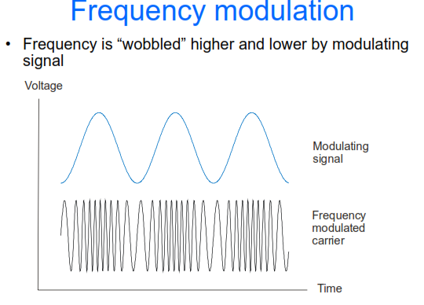

Slide 7
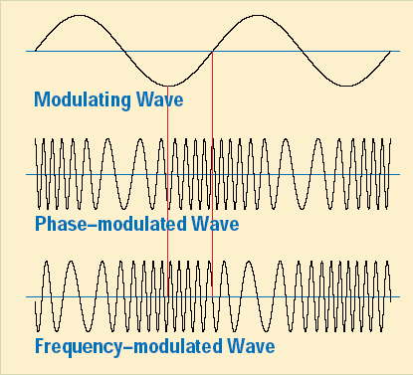

Slide 8
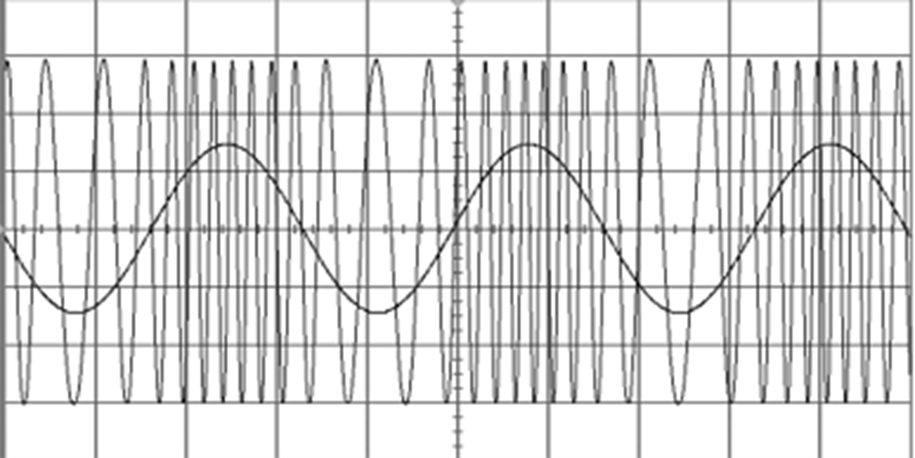
Modulasi Frekuensi (FM)
Modulasi Frekuensi (FM)

Slide 9
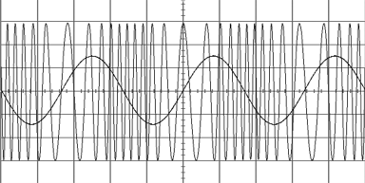
Modulas PHASA(PM)

Slide 10
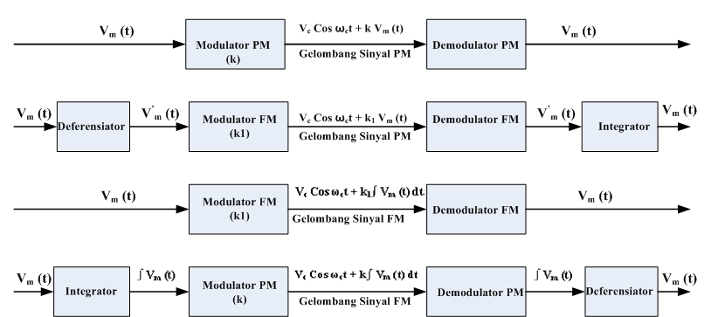
Modulator dan Demodulator PM, FM
Modulator PM = Deferensiator + Modulator FM
Modulator FM = Integrator + Modulator PM
Demodulator FM = Demodulator PM + Deferensiator.
Demodulator PM = Demodulator FM + Integrator

Slide 11

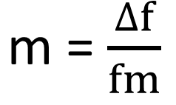
Analisis Sinyal FM
Sinyal FM :
Dimana m = Indeks modulasi
∆f = Simpangan / deviasi maksimum sinyal FM
Fm = frekuensi maksimum sinyal informasi

Slide 12

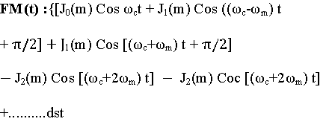

Slide 13
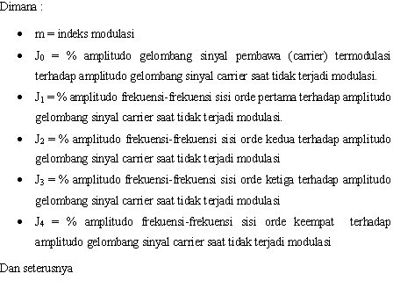

Slide 14
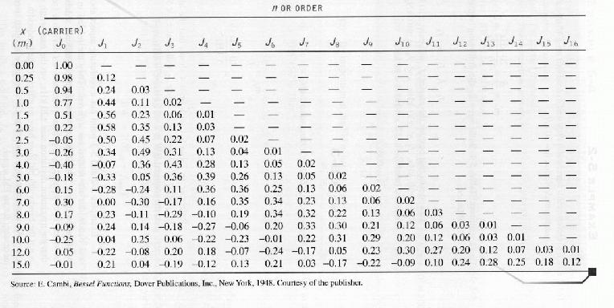
Frekuensi-frekuensi Sisi Gelombang Sinyal FM dari Fungsi Bessel

Slide 15
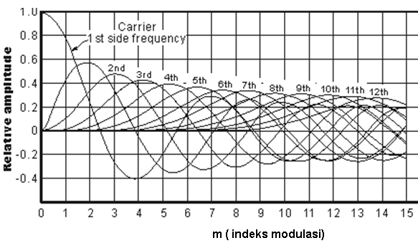

Slide 16
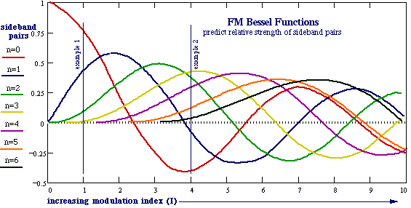

Slide 17
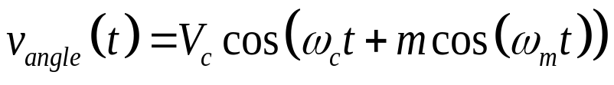
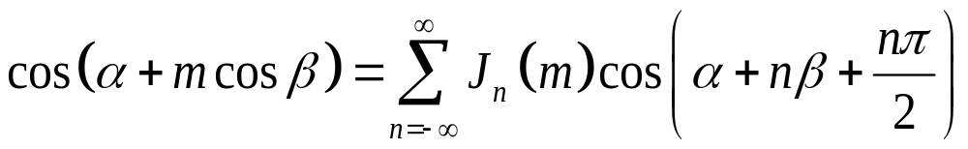
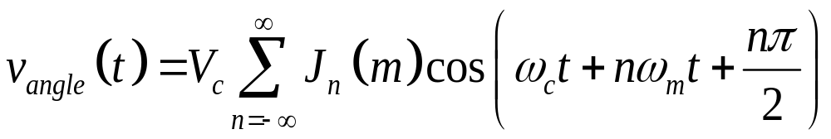
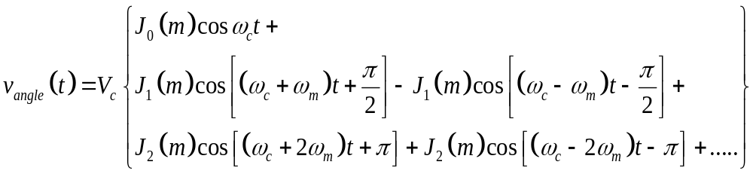
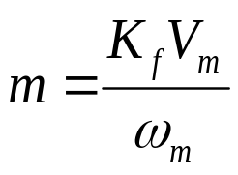

Spektrum
Jn (m) is the Bessel function of the first kind
FM:
PM:

Slide 18
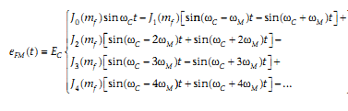
Fungsi Bessel yg berkaitan dg FM

Slide 19
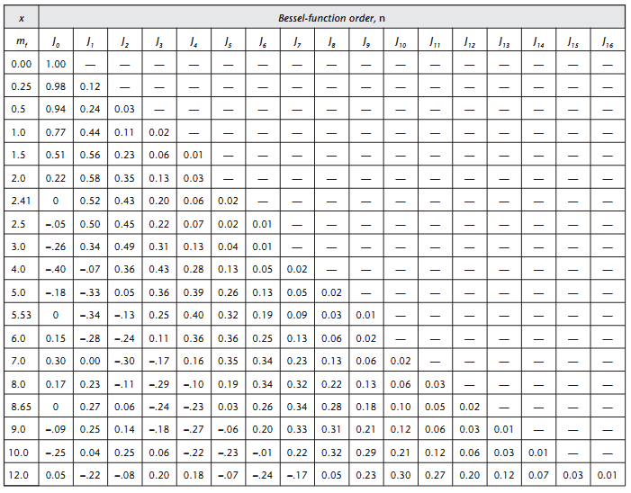
Tabel Fungsi Bessel

Slide 20
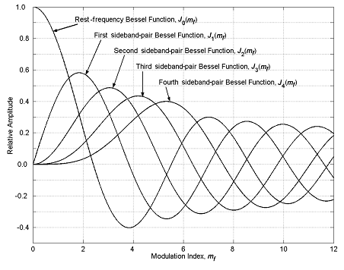

Slide 21

Spektrum dan Bandwidth Sinyal FM
Berdasarkan fungsi Bessel, bandwidth gelombang sinyal FM :
Bw = 2.n.f_{m}
Bandwidth gelombang sinyal FM berdasar atas rumus Carlson :

Slide 22
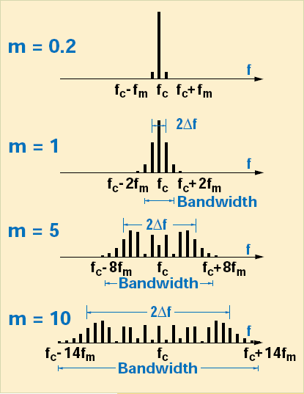
Spektrum Gelombang Sinyal FM :

Slide 23
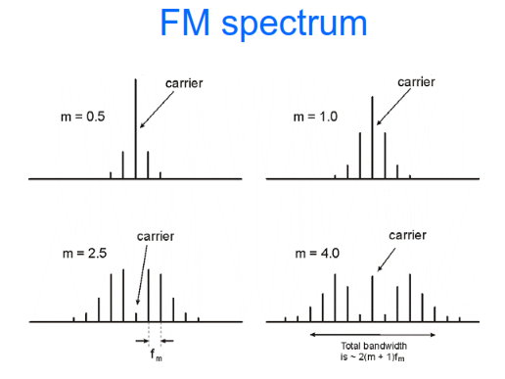

Slide 24
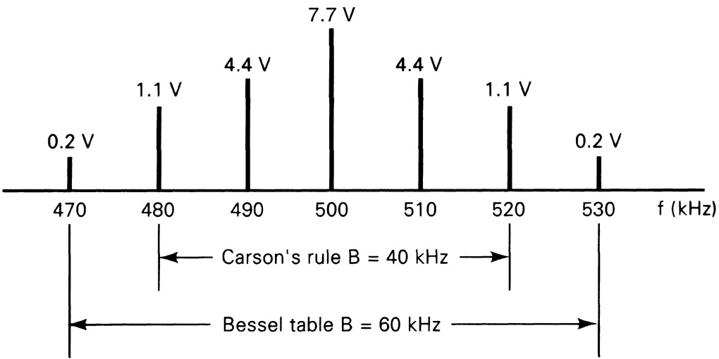
FM modulator: Δf = 10 kHz, f_{m} = 10 kHz, V_{c} = 10 V, f_{c} = 500 kHz, m=1

Slide 25


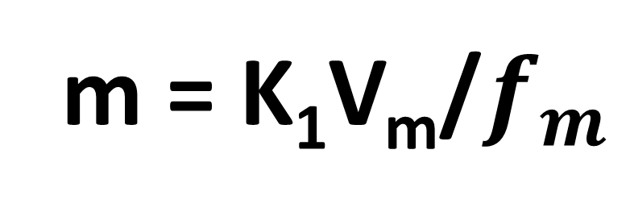
The Index of Modulation
m = K₁V_{m}/$f_{m}$
Dimana :
m = indeks modulasi
= Deviasi frekuensi maksimum
= Frekuensi maksimum sinyal
informasi/ sinyal pemodulasi

Slide 26
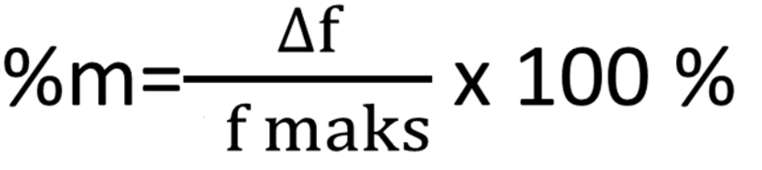

Percentage of Modulation
Dimana : = deviasi maksimum
standar siaran FM komersial = 75 Khz

Slide 27
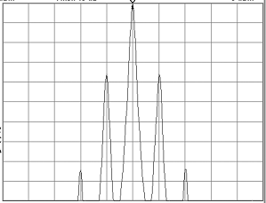
Spektrum FM

Slide 28
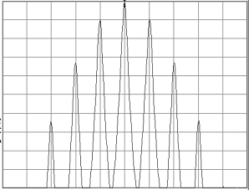

Slide 29

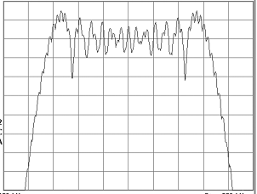

Slide 30

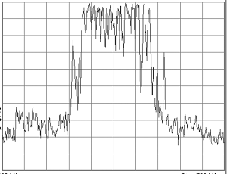

Slide 31

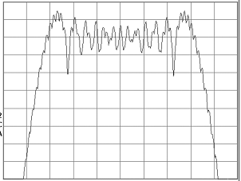

Slide 32

Daya pada Sinyal FM
Daya yang dipancarkan konstan baik saat tidak terjadi proses modulasi maupun saat terjadi proses modulasi.

Slide 33
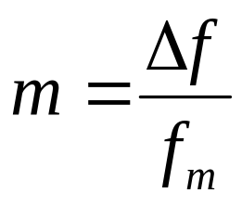
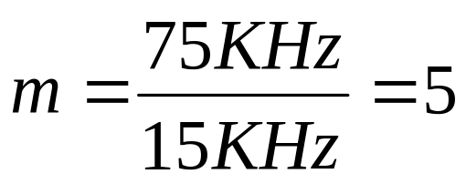
Example
  Commercial FM broadcasting stations restrict the maximum carrier frequency deviation to 75 KHz . A single modulating tone of 15 KHz is used to produce the peak frequency deviation of the carrier.
  Determine the modulation index ?

Slide 34
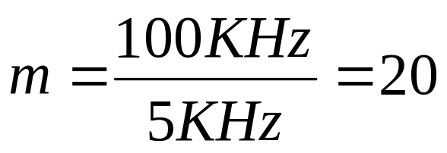
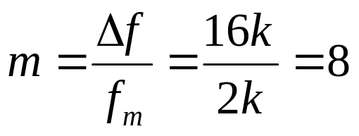
If the peak frequency deviation of the carrier is 100 kHz, and is produced by a 5 kHz modulating tone.
Determine the modulation index ?
A FM system has a maximum frequency deviation of
50KHz. A test signal of 4V, 2KHz produces a frequency
deviation of 16KHz.
Determine the modulation index ?

Slide 35
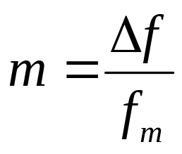
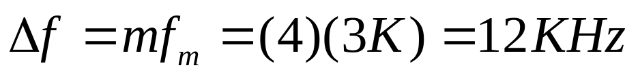
4. A FM system has the following properties: f_{m} = 3KHz, V_{m} = 3v, m = 4, V_{c} = 2v, f_{c} = 200KHz
Determine the frequency deviation ?
Modulation index
Thus

Slide 36
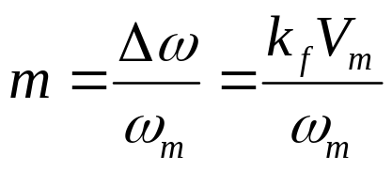
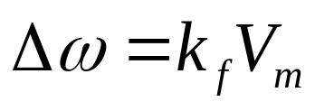
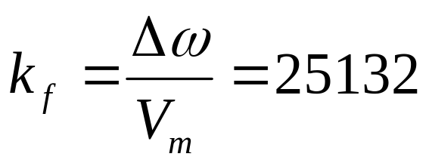
A FM system has the following properties: f_{m} = 3KHz, V_{m} = 3v,
m = 4, V_{c} = 2v, f_{c} = 200KHz
Determine the modulation sensitivity ?
Modulation index
Thus
Thus

Slide 37
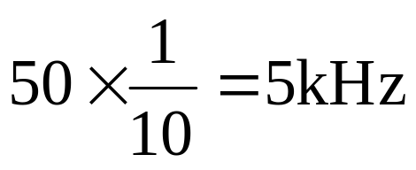
6. Given that the deviation constant is 1kHz/10mV, what is
the shift in frequency for a voltage level of 50 mV?
Frequency deviation ∆f =
In an FM system when the audio frequency is 300 Hz and the audio voltage is 2.0V, the deviation is 5kHz. If the audio voltage is now increased to 6V what is the new deviation? If the voltage is now increased to 9V and the frequency dropped to 100Hz what is the deviation? Find the modulation index in each case.

Slide 38
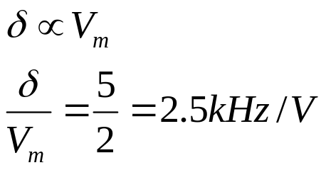
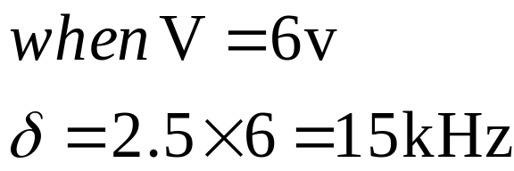
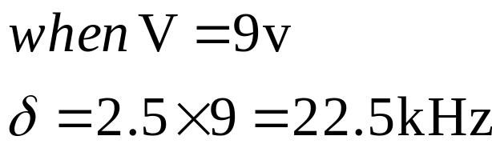
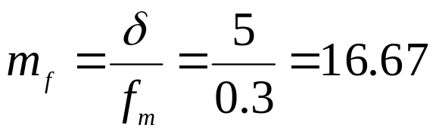
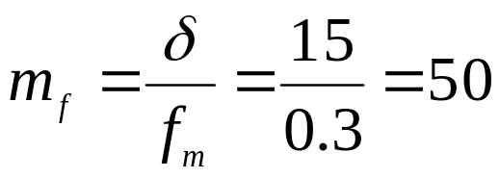
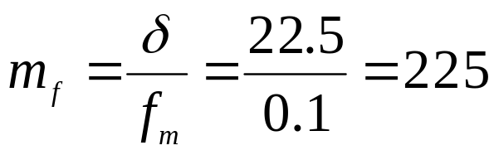
7. In an FM system when the audio frequency is 300 Hz and the
audio voltage is 2.0V, the deviation is 5kHz. If the audio
voltage is now increased to 6V what is the new deviation? If
the voltage is now increased to 9V and the frequency dropped
to 100Hz what is the deviation? Find the modulation index in
each case.
$$δ=∆f=Deviasi frekuensi maksimum$$

Slide 39





Find the carrier and modulating frequencies, the modulating
index, and the max. deviation of an FM wave below. What
power will the wave dissipate in a 10 ohm resistor?
Compare this with:
Modulating index=5 as given.
Power,

